Slide 1
Urban Watersheds
Learning Module #3

Slide 2
Agenda
Time | Length | Activity
9:00 | 15 min | Opening Activity
9:15 | 1 hour | “Color me a Watershed” from Project WET
10:15 | 15 min | BREAK
10:30 | 20 min | Guided Notes
10:50 | 10 Min | BREAK
11:00 | 1 hour, 15 min | Campus Watersheds
12:15 | 15 Min | Closing Activity

Slide 3
Opening Activity
Instructions:
Write your response to the questions on the paper.
Share with a partner
Class discussion

Slide 4
Opening Activity
Why is access to clean/healthy? water important?
What are some factors that might make a water supply polluted or unhealthy?

Slide 5
“Color Me a Watershed”
1 square on map = 1 km²
Each map = 360 km²
Notes:
In this activity, we are going to explore how land cover and change over time might affect water quality.
These three maps represent aerial views of land taken over 100 years.

Slide 6
“Color Me a Watershed”
Instructions:
Designate each land type with a different color
Color code map
For each land type, determine:
Total km²
% coverage
Move on to the next map (use same color-coding)
1 square on map = 1 km²
Each map = 360 km²

Slide 7
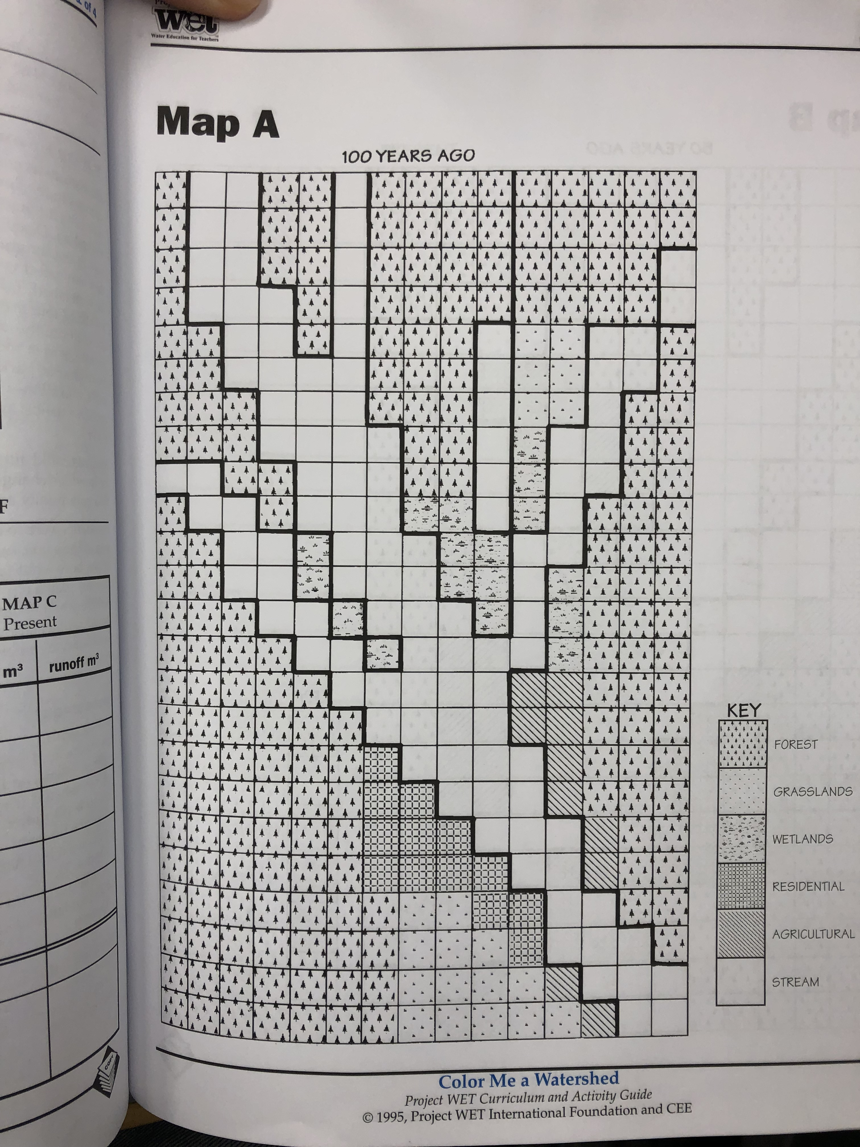
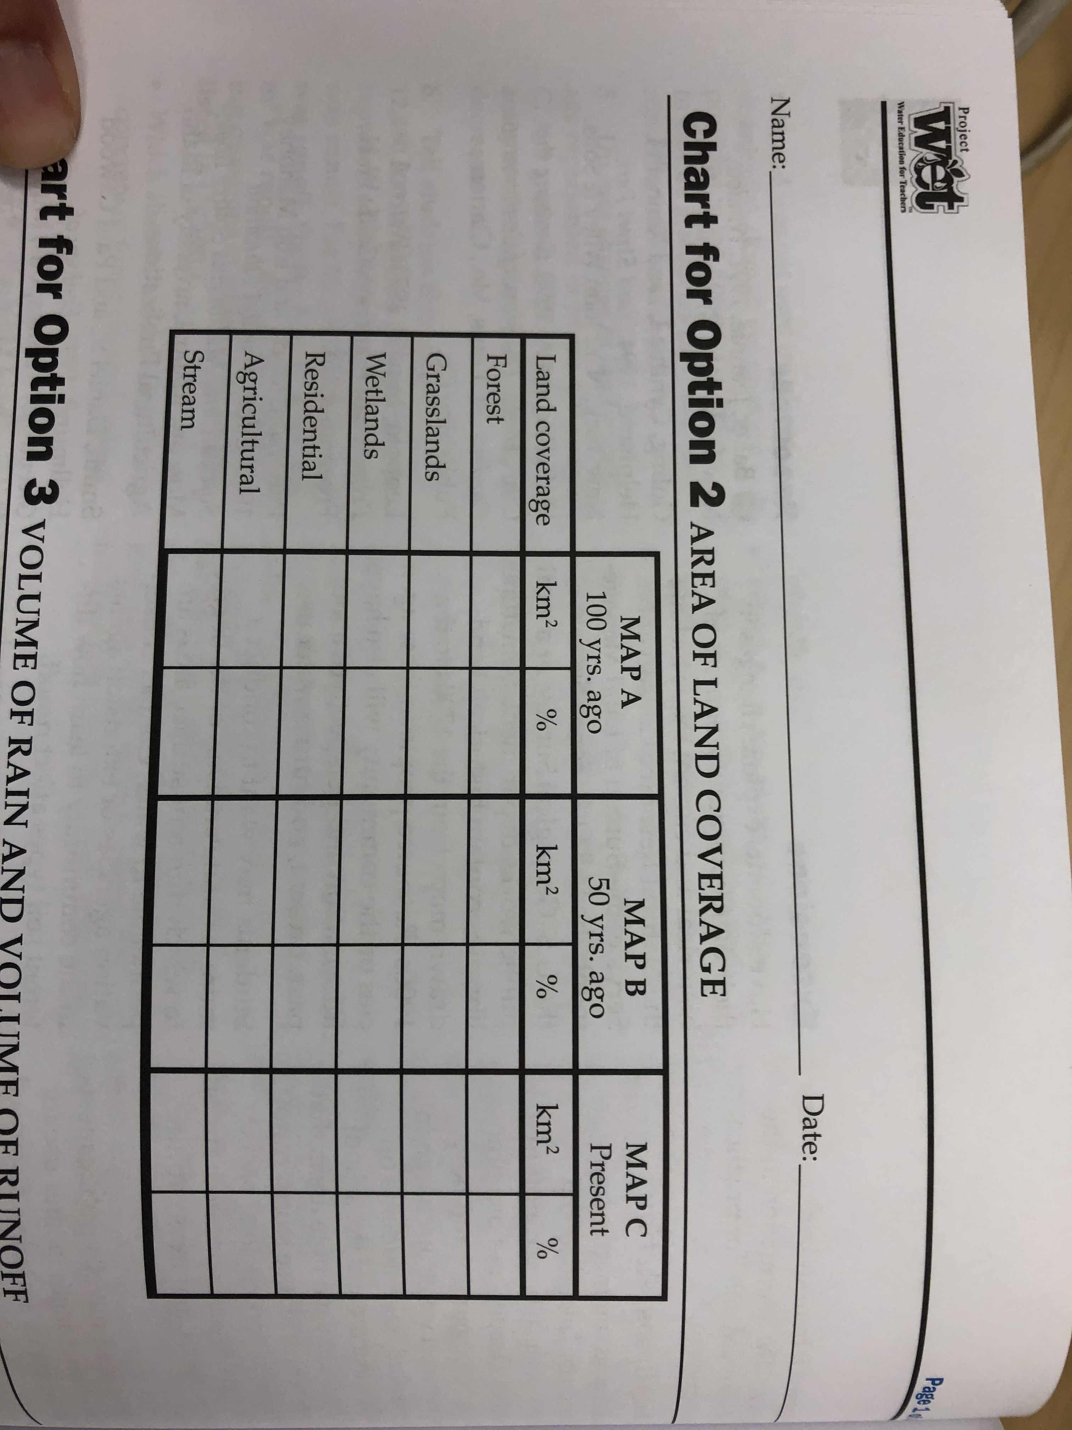
“Color Me a Watershed” – example
Notes:
Example for residential in Map A
13 km2
= 3.6%

Slide 8
“Color Me a Watershed” -- Discussion
What happens to the amount of forested land as you go from Map A to Map C?

Slide 9
“Color Me a Watershed” -- Discussion
What happens to the amount of forested land as you go from Map A to Map C?
Which has the most land devoted to residential (in other words, human settlements)?

Slide 10
“Color Me a Watershed” -- Discussion
What happens to the amount of forested land as you go from Map A to Map C?
Which has the most land devoted to residential (in other words, human settlements)?
Where are the most human settlements located? Why do you think that is?

Slide 11
“Color Me a Watershed” -- Discussion
What happens to the amount of forested land as you go from Map A to Map C?
Which has the most land devoted to residential (in other words, human settlements)?
Where are the most human settlements located? Why do you think that is?
What effect might these human settlements have on the stream? Good or bad?

Slide 12
Take
a
break!

Slide 13
Guided Notes
Instructions:
Listen and ask questions!
Write down anything you see that is bold, brown, and underlined

Slide 14

Why are urban watersheds unique?
A Watershed learning network module
This material was generated as part of a collaboration between members of the Atlanta Watershed Learning Network and students and faculty of a service learning course in urban ecology. The views and opinions expressed in these materials are those of the authors and do not necessarily reflect the official policy or position of the University of Georgia.
Notes:
In this module, we will discuss what is a watershed and why they are important. We will discuss some important definitions and discuss how urbanization influences watershed function.
This material was based on a curriculum developed by members of the Atlanta Watershed Learning Network, led by Dr. Yomi Noibi of Eco-Action.
Unless otherwise noted, all of the diagrams and models used in the modules were created by Diane Kelment, the video material was captured and edited in large part by Allison Krausman, and the images used in the modules were taken by the students or instructor of the urban ecology course at UGA in 2018 or the West Atlanta Watershed Alliance.
The views and opinions expressed in these materials are those of the authors and do not necessarily reflect the official policy or position of the University of Georgia.

Slide 15
Everyone Lives In a Watershed!
Watershed -- an area of land where water drains into a larger body of water
http://www.portal.state.pa.us/portal/server.pt?open=514&objID=588795&mode=2
Notes:
Everyone does live in a watershed.
A watershed is an area of land where water from rain or snow drains into a larger body of water, such as rivers, marshes, lakes or oceans.
As you can see in this figure, water entering a watershed through surface water, such as rain or snow, flows downhill.

Slide 16
Everyone Lives In a Watershed!
Watershed -- an area of land where water drains into a larger body of water
http://www.portal.state.pa.us/portal/server.pt?open=514&objID=588795&mode=2
Notes:
Think back to our ”Color me a Watershed” Activity. Each map – A, B, and C – represented a watershed.

Slide 17
Everyone Lives In a Watershed!
Watershed -- an area of land where water drains into a larger body of water
Filtration/Percolation – when water drains through the soil
Groundwater – water held underground in soil or rock
http://www.portal.state.pa.us/portal/server.pt?open=514&objID=588795&mode=2
Notes:
If surface water percolates, or drains through soil, it can enter the groundwater.
Groundwater is water held underground in soil or rock
Both surface water and ground water flow into larger bodies of water.

Slide 18
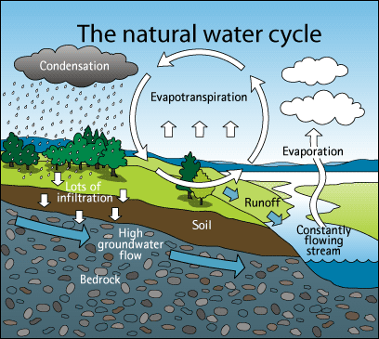
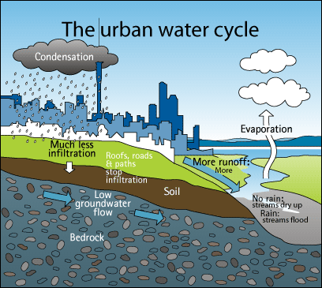
http://www.blueplanet.nsw.edu.au/year-7-and-8-natural-and-urban-water-cycles/.aspx
Notes:
The natural water cycle is a series of connected processes of evaporation, condensation, precipitation and groundwater flow.
The water cycle still exists in urban areas, but it is influenced by the amount of and type of development and changes in climate and geology associated with growing towns and cities. Urbanization influences the water cycle in many important ways, however, for the purpose of our discussion, we will primarily be focusing on increases in surface runoff due to decreases in percolation or filtration
These images were taken from the BluePlanet website, who credit the Aukland Council with the development of the images.

Slide 19
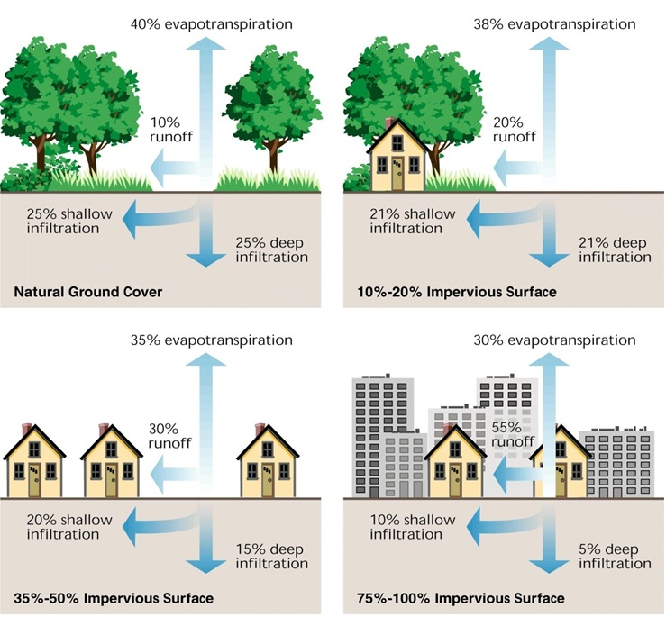
Stream Restoration: Principles, Processes and Practices (Federal Interagency Stream Restoration Working Group, USA 1998)
Notes:
In a natural system, approximately only 10% of the water coming into the system as precipitation will create surface runoff, or water flowing over land. The remaining water will either filter into the ground through the soil (percolation) or go back into the atmosphere through evapotranspiration, the process of water evaporating from land and water and or being transpired or released by plants.
From: Stream Restoration: Principles, Processes and Practices (Federal Interagency Stream Restoration Working Group, USA 1998). https://www.nrcs.usda.gov/Internet/FSE_DOCUMENTS/stelprdb1044574.pdf

Slide 20
Impervious cover – surfaces that do not permit water filtration through the soil
Stream Restoration: Principles, Processes and Practices (Federal Interagency Stream Restoration Working Group, USA 1998)
Notes:
However, increasing impervious cover, or surfaces that do not permit water filtration through the soil, in a watershed results in increased surface runoff. Impervious surfaces include roads, parking lots, and roofs.
As we can see from this figure, as little as 10 percent impervious cover in a watershed can result in increases in the amount of water running over land.
From: Stream Restoration: Principles, Processes and Practices (Federal Interagency Stream Restoration Working Group, USA 1998). https://www.nrcs.usda.gov/Internet/FSE_DOCUMENTS/stelprdb1044574.pdf

Slide 21
Why is increased surface runoff in urban watersheds a problem?
Notes:
^^Wait for student response

Slide 22
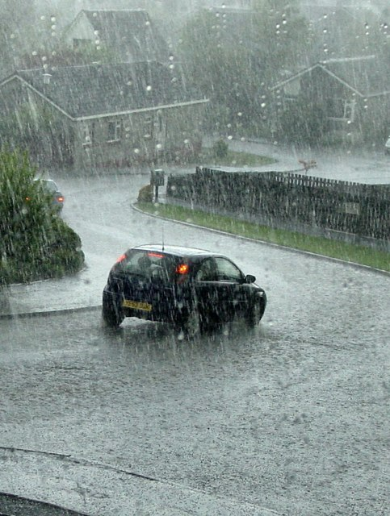
Why is increased surface runoff in urban watersheds a problem?
Increased surface runoff =
Increased sediment transport
Increased pollutant transport =
More polluted streams!!
Image credit: Iain Farquhar /
Torrential rain and hail in a thunderstorm at Barons Hill Avenue

Slide 23
How can we keep track of pollution in our streams and rivers?

Slide 24
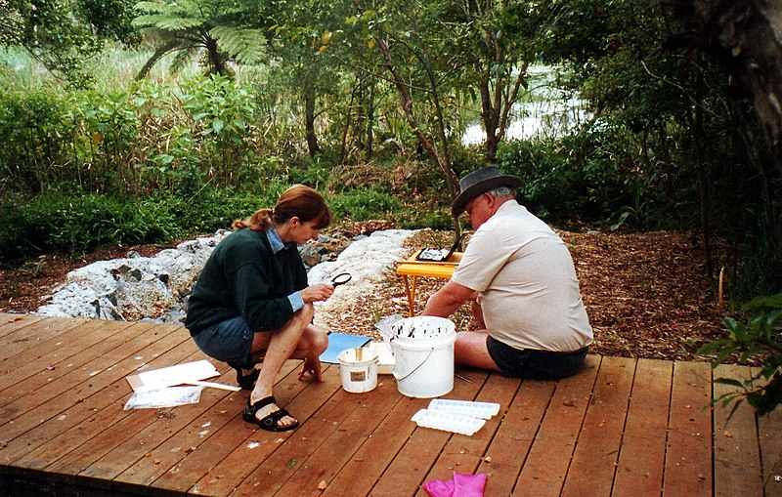
How can we keep track of pollution in our streams and rivers?
Water quality monitoring – sampling and analysis of water conditions
Photo credit: Brian Tolagson, CC BY-SA 4.0 <https://creativecommons.org/licenses/by-sa/4.0>, via Wikimedia Commons
Notes:
We will be learning many ways to monitor the quality of streams over the course of the next two weeks!!

Slide 25
Take
a
break!

Slide 26
Campus Watersheds
http://waterlight.mynmi.net/watershed.html
Notes:
We will be focusing our water quality monitoring efforts on a campus stream. Before we begin learning different ways to conduct water quality monitoring, we want to learn a little bit about the watersheds and about the history of the campus streams.
Does anyone know what streams are on University of Georgia’s campus?

Slide 27
Campus Watersheds
Instructions:
Read Tanyard OR Lily page (depending on group) silently
Circle words or terms you do not understand

Slide 28
Campus Watersheds
Instructions:
Read Tanyard OR Lily page (depending on group) silently
Circle words or terms you do not understand
Work with group to create list of unknown terms. Once you do this, each group will share the unknown terms with the class and we’ll work together to define them!
Notes:
Then, define terms as a class

Slide 29
Campus Watersheds – Campus Stream Poster
Information to Include
Name of stream
Drawing of Watershed Shape
% Impervious Surface (estimate)
% Ownership of Land (example: UGA vs. residential)
Stream Length
Brief History
Summary of Water Quality Problems

Slide 30
Campus Watersheds – Campus Stream Poster
Share out with class!

Slide 31
Closing Activity
Instructions:
Write your response to the questions on the lesson worksheet.

Slide 32
Closing Activity
How are urban watersheds different than non-urban watersheds? Explain with words or draw a picture.
How can urbanization negatively affect stream health? Explain in words.

